Slide 1

IMPACT OF SOCIAL MEDIA USAGE ON STUDENT’S MENTAL HEALTH: A STATISTICAL ANALYSIS University Post Graduate College (OU) , Secunderabad (A Constituent College Of Osmania University) DEPARTMENT OF COMPUTER SCIENCE M.SC.DATA SCIENCE II YEAR [2024-2026] Submitted by K.Paavani - 101024559017 Under the Guidance Of Dr.B.RANGANATHA RAO (assistant professor(c), Dept of Computer Science)

Slide 2

Introduction
Social media is widely used among students for communication, learning and entertainment.
Excessive usage affects mental health such as stress, anxiety, and depression.
Digital behaviour influences sleep, productivity, and emotional well-being.
Statistical analysis helps understand patterns and relationships in data.

Slide 3
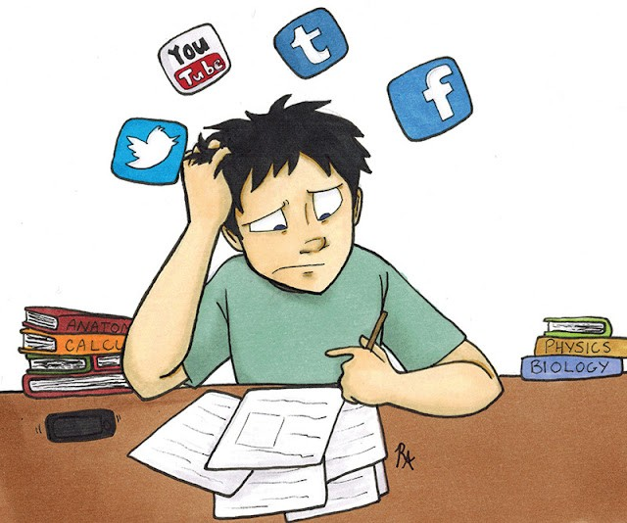
Motivation for Research
Rapid increase in social media usage among students.
Rising mental health issues like stress and anxiety.
Lack of awareness about healthy usage patterns.
Need for data-driven insights to understand behavioural impact.
Statistical analysis helps identify hidden patterns and key factors.

Slide 4
Literature Review
Paper Title | Author | Approach | Findings | Limitations
Social Media Usage and Academic Performance Among Medical Students in Medina, Saudi Arabia | Alshanqiti A. et al. (2023) | Cross-sectional survey with statistical tests | High social media usage negatively affects academic performance | Uses only basic statistical tests like Chi-square and Fisher’s test; lacks advanced techniques like regression or multivariate analysis
The Impact of Social Media on Academic Performance and Interpersonal Relations Among Health Sciences Undergraduates | Chandrasena P.P.C.M. et al. (2022) | Descriptive cross-sectional statistical study | Social media affects sleep, productivity, and interpersonal relationships | Uses basic statistical methods such as descriptive statistics, t-test and ANOVA; lacks advanced modeling techniques

Slide 5
Literature Review
Paper Title | Author | Approach | Findings | Limitations
The Effects of Social Media Addiction, Academic Stress, and Sleep Quality on Anxiety Symptoms | Zheng G., Peng H. (2025) | Cross-sectional study with correlation and mediation analysis | Social media addiction, stress, and poor sleep increase anxiety levels | Focuses mainly on correlation and mediation analysis; does not include clustering or classification techniques
Excessive Social Media Use and Its Impact on Psychological Well-Being and Academic Performance of Vietnamese University Students | Duc T.M. (2026) | Structural Equation Modeling (PLS-SEM) | Social media overuse increases psychological distress and reduces academic performance | Uses SEM but lacks complementary techniques like clustering or regression comparison models
Social Media Use and Academic Performance Among College Students | Gong Z., Guo Y., Tan J. (2025) | Structural Equation Modeling with mediation and moderation analysis | Social anxiety and FoMO mediate the negative impact on academic performance | Focuses on SEM-based modeling; lacks simpler statistical validation methods like ANOVA or clustering

Slide 6
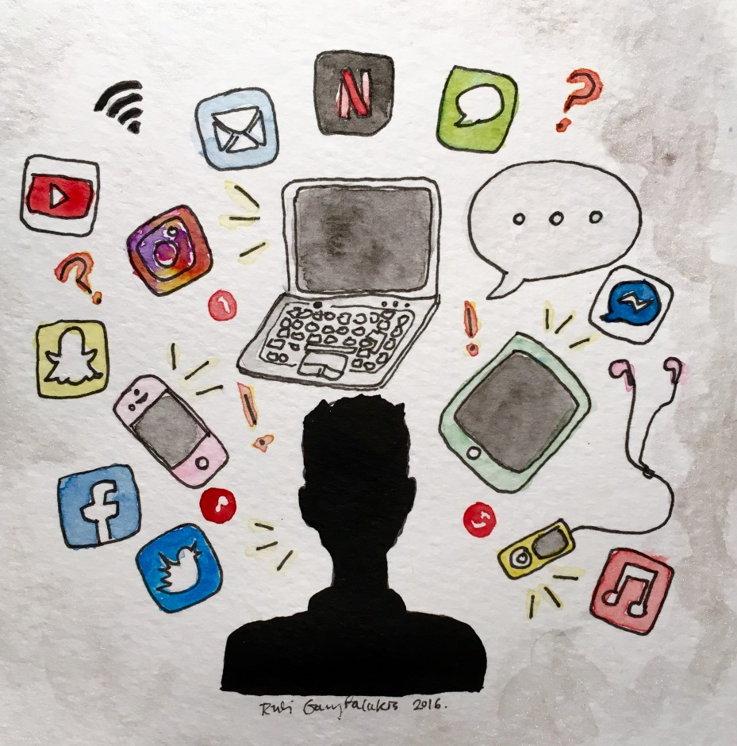
Problem Statement
Lack of comprehensive statistical analysis to understand the impact of social media usage on students’ mental health
Limited use of advanced statistical techniques in existing studies
Incomplete analysis of combined behavioral and psychological factors such as sleep, stress, and anxiety
Absence of classification of students based on usage patterns and mental health conditions
Lack of practical, data-driven insights and recommendations

Slide 7
Research Objectives
Objective 1: To analyse student data to identify patterns in social media usage and mental health.
Objective 2: To examine the impact of usage, behaviour, and academics on mental health.
Objective 3: To apply statistical techniques to model relationships among variables.
Objective 4: To classify students into risk groups based on usage and mental health.
Objective 5: To provide data-driven insights for improving mental health.

Slide 8
Methodology
Dataset: Social Media & Mental Health (Kaggle)
Link: https://www.kaggle.com/datasets/sonalshinde123/social-media-mental-health-indicators-dataset
Size: 5000 samples, 15 variables
Includes behavioural, psychological, and lifestyle data
Preprocessing:
Handle missing values using mean and mode
Convert categorical data into numbers
Normalize numerical values
Remove outliers
Clean and remove duplicate data
Descriptive Analysis and Visualization
Calculate mean, median, and standard deviation
Use histograms, bar charts, and boxplots
Understand data distribution and patterns

Slide 9
Methodology
Exploratory Data Analysis (EDA)
Analyse relationships between variables
Use correlation matrix and heatmaps
Identify key trends and patterns
Advanced Statistical Techniques
Chi-square Test → Association between categorical variables
ANOVA → Comparison of group means
Correlation Analysis → Strength of relationships
Logistic Regression → Prediction of mental health outcome
Cluster Analysis → Grouping students into risk categories
Result Interpretation
Analyse statistical significance (p-value < 0.05)
Identify major influencing factors
Interpret results in real-world context

Slide 10
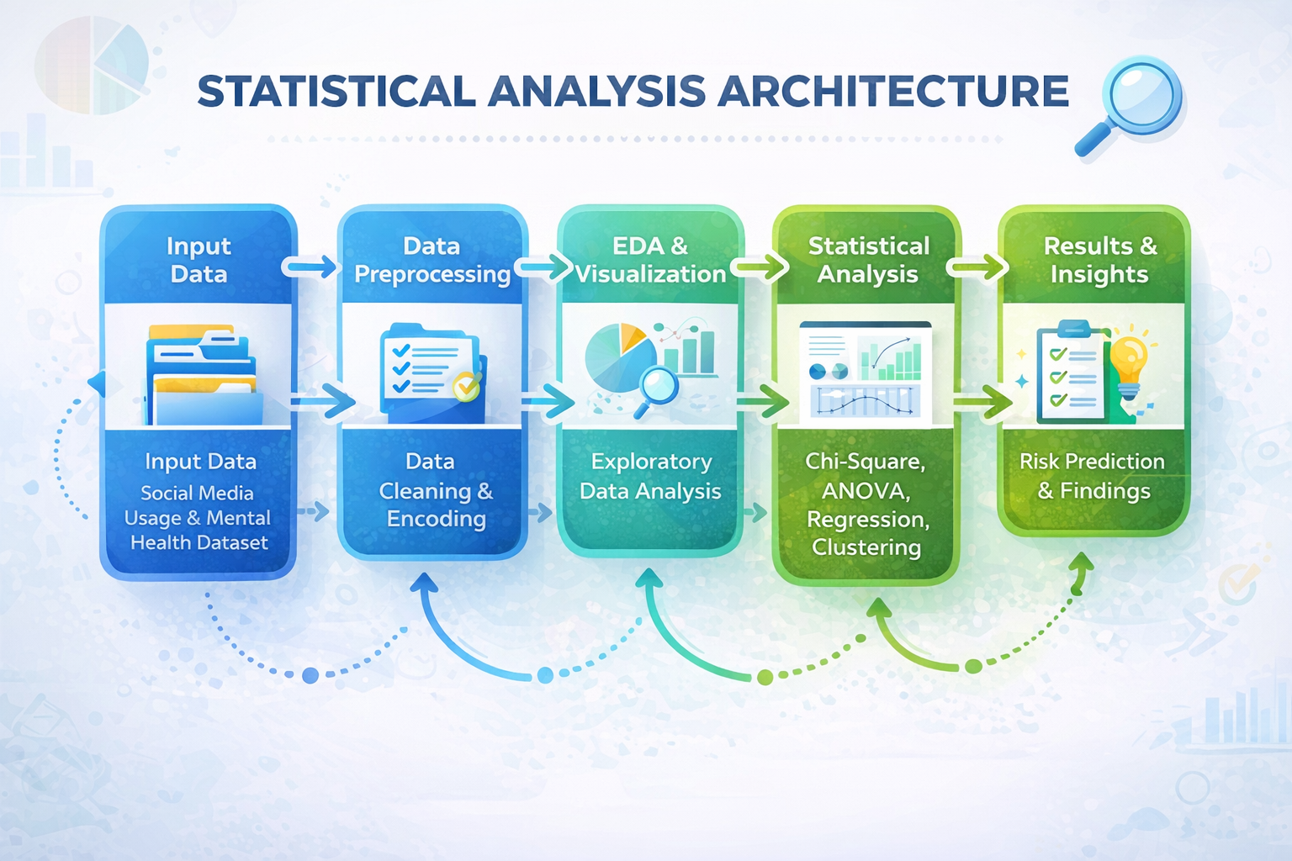
Methodology – Workflow (Architecture)

Slide 11
References
Alshanqiti A., Alharbi O.A., Ismaeel D.M., Abuanq L. (2023) Social Media Usage and Academic Performance Among Medical Students in Medina, Saudi Arabia
Chandrasena P.P.C.M., Ilankoon I.M.P.S. (2022) The Impact of Social Media on Academic Performance and Interpersonal Relations Among Health Sciences Undergraduates
Zheng G., Peng H. (2025) The Effects of Social Media Addiction, Academic Stress, and Sleep Quality on Anxiety Symptoms
Duc T.M. (2026) Excessive Social Media Use and Its Impact on Psychological Well-Being and Academic Performance of Vietnamese University Students
Gong Z., Guo Y., Tan J. (2025) Social Media Use and Academic Performance Among College Students

Slide 12
THANK YOU Queries & Suggestions

